Slide 1




Two Dimensional Graphics
(Graphics, Part 4)
Visualizing Real Data

Slide 2
Introduction
Visualizing data is a common request in some applications.
Graphical data is easier to stand than text
Programmers should have the skill at data visualization
Demo: Creating Line Chart for a time series

Slide 3
Contents
Normal Coordinates versus Device Coordinates
Expected Shape
Mapping a Real Point to Device Point
Drawing Area in a Component

Slide 4
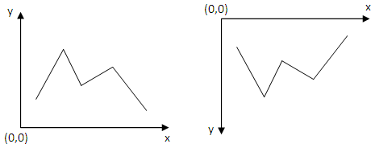
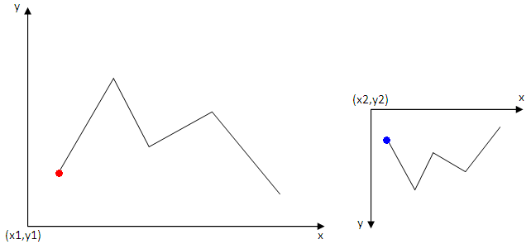
Normal Coordinates versus
Device Coordinates
Normal Coordinates
Device Coordinates
?
Mapping
Normal Coordinates
Device Coordinates

Slide 5
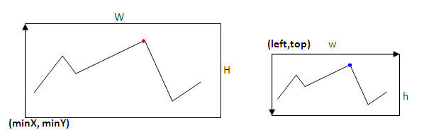
Expected Shape
Common used shape
The shape will be on device
A mapping is needed to exchange a real point to an on-device point

Slide 6
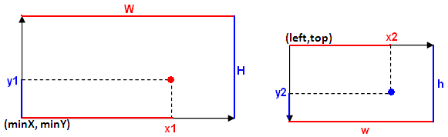
Mapping a Real Point to Device Point
Normal Coordinates
Device Coordinates
Properties of the point must be preserved
Computing x2
(x1-minX)/W = (x2-left)/w → x2 = left + (x1-minX)*w/W
Let C_{W} = w/W
x2 = left + C_{W}(x1-minX)
x2 = C_{w}x1 + left – C_{w}minX

Slide 7
Mapping a Point - 1
0
Normal Coordinates
Device Coordinates
top
Properties of the point must be preserved
Computing y2
(y1-minY)/H = (top+h-y2)/h
(y1-minY)*h/H = top +h –y2
Let C_{h} = h/H
y2 = top + h – C_{h}(y1-minY)
y2 = -C_{h}y1 + C_{h}minY + top + h
y2
h

Slide 8
Mapping a Point - 2
x2 = C_{w}x1 + left – C_{w}minX
x2 = C_{w}x1 + C1
y2 = - C_{h}y1 + C_{h}minY + top + h
y2 = - C_{h}y1 + C₂
Classes can be use in Java API:
java.awt.Dimension: An area on component
java.awt.geom.AffineTransform for mapping a point in one window to another

Slide 9
Drawing Area in a Component
y
Drawing Area
x
Gaps should be reserved:
Gaps between component’s boundaries and coordinates' boundaries
Gaps between coordinates' boundaries and drawing boundaries

Slide 10
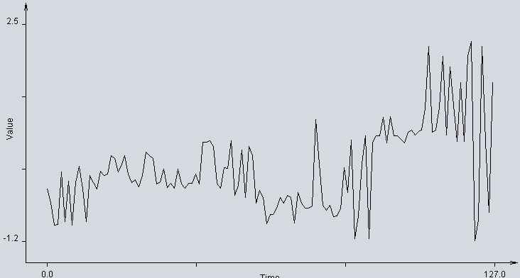
Demo: Creating Line Chart
A time series is a sequence of data points, typically consisting of successive measurements made over a time interval. Examples of time series are electrocardiograms (ECG), ocean tides, counts of sunspots, and the daily closing value of the Dow Jones Industrial Average. Time series are very frequently plotted via line charts. (Wikipedia)
Notes:
electrocardiogram (ECG): Điện tâm đồ

Slide 11
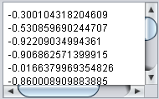
Demo - 1
This demonstration depicts how to draw a line chart for a time series.
Time series is usually stored as a list of values, time intervals are default. Example:
They can be considered as points:
(0, -0.300104318204609)
(1, -0.530859690244707)
(2, -0.92209034994361)
(3, -0.906862571399915)
….

Slide 12
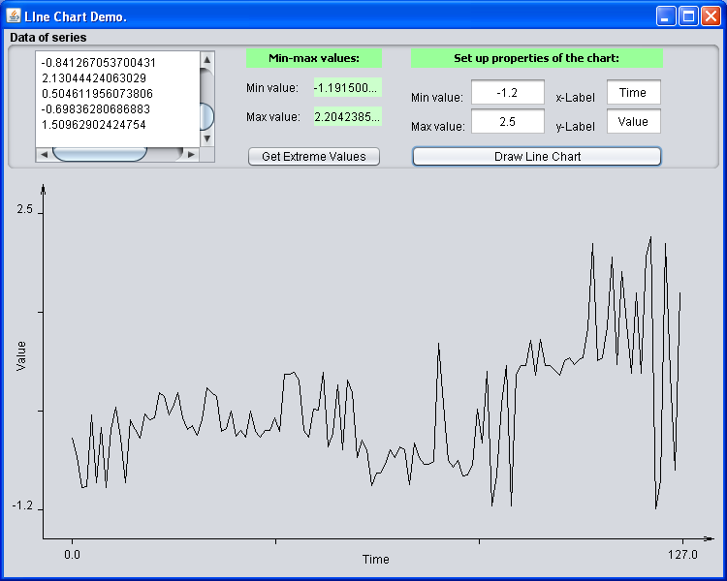
Demo - 2
GUI

Slide 13
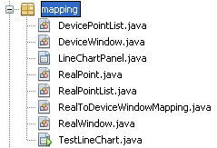
Demo - 3
Class Design
A list of integral points on a device
An area in device coordinates
Panel contains ability for drawing a line chart which representing a list of real points
A point in real coordinates
A list of real points
Mapping a real window to a device window
An area in real coordinates
GUI program

Slide 14
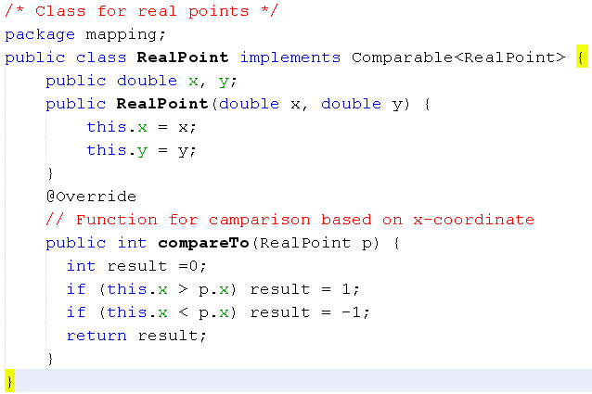
Demo: Code - 1

Slide 15
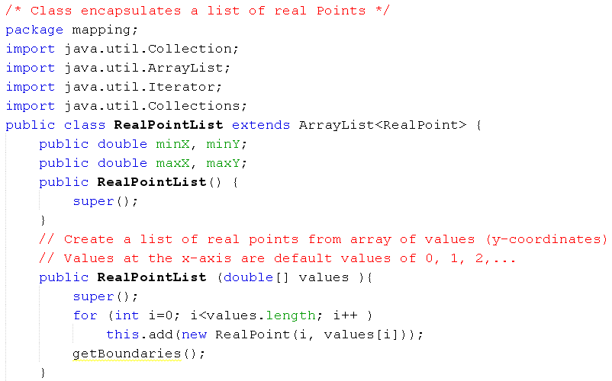
Demo: Code - 2

Slide 16
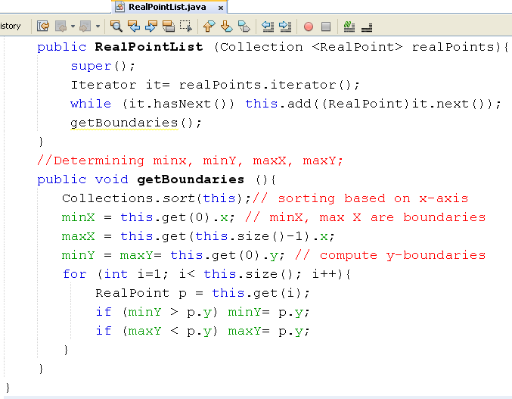
Demo: Code - 3

Slide 17
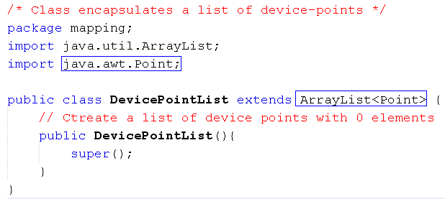
Demo: Code - 4

Slide 18
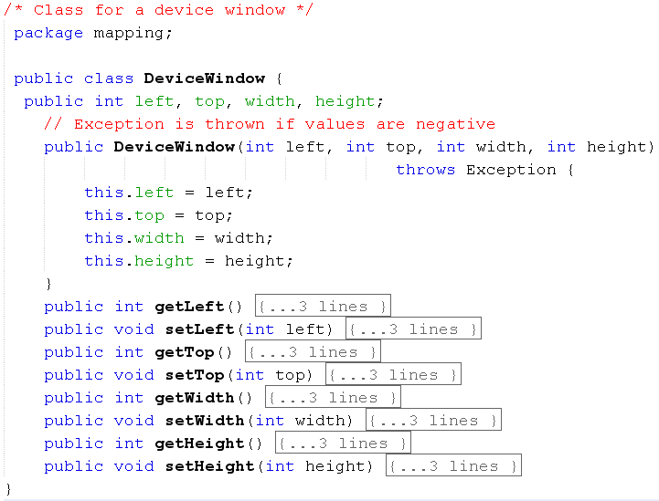
Demo: Code - 5

Slide 19
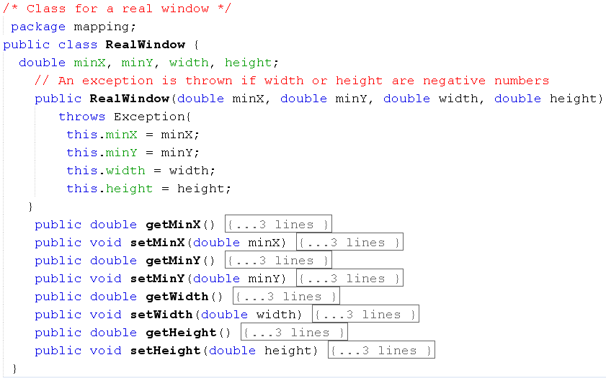
Demo: Code - 6

Slide 20
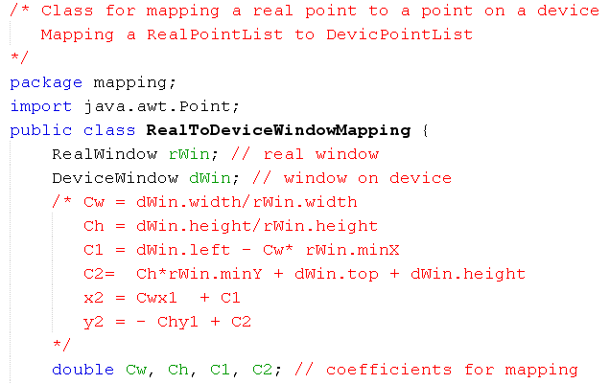
Demo: Code - 7

Slide 21
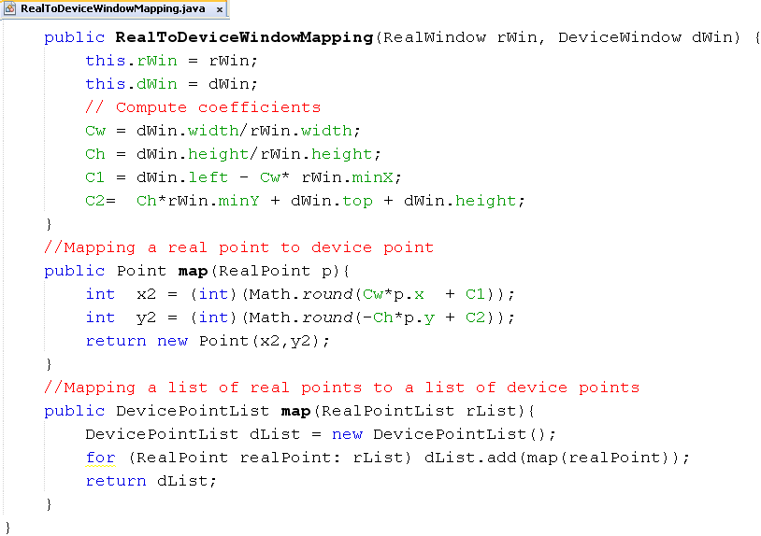
Demo: Code - 8

Slide 22
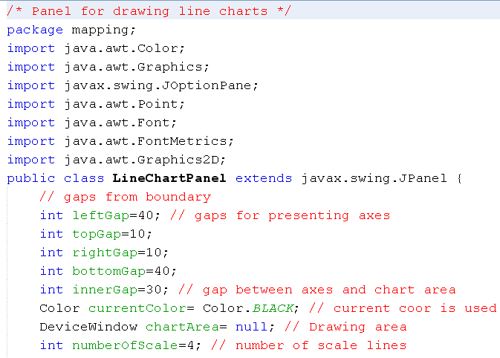
Demo: Code - 9

Slide 23
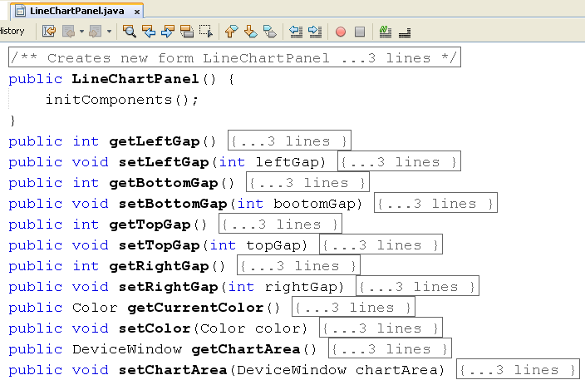
Demo: Code - 10
Constructor, getters, setters

Slide 24
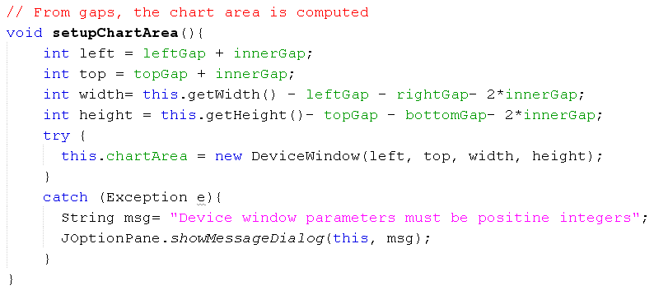
Demo: Code - 11

Slide 25
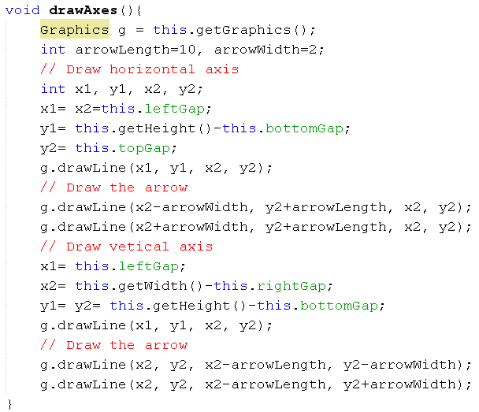
Demo: Code - 12

Slide 26
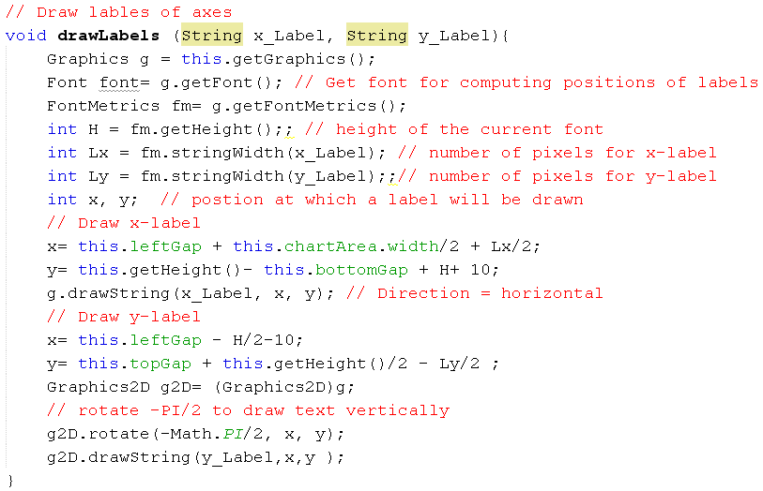
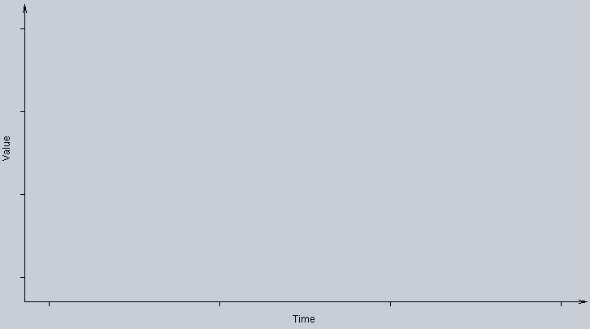
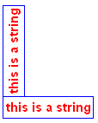

Demo: Code - 13

Slide 27
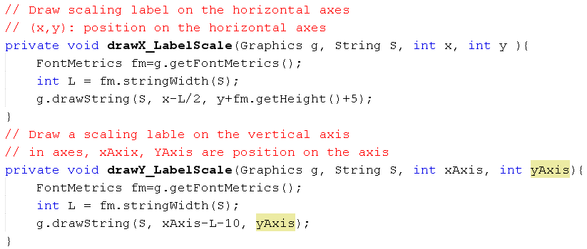
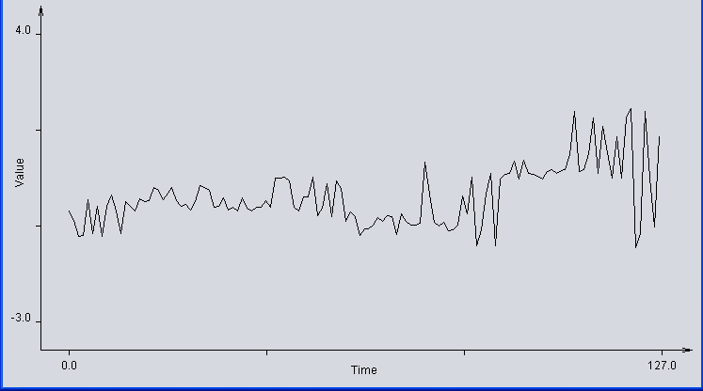
Demo: Code - 14

Slide 28
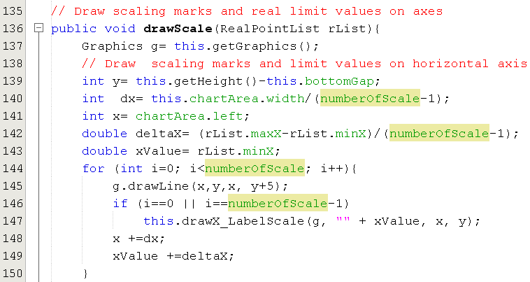
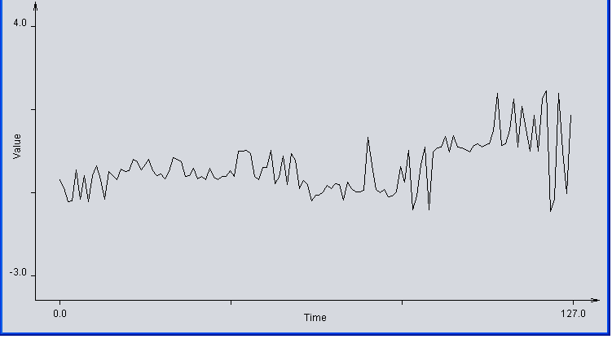
Demo: Code - 15

Slide 29
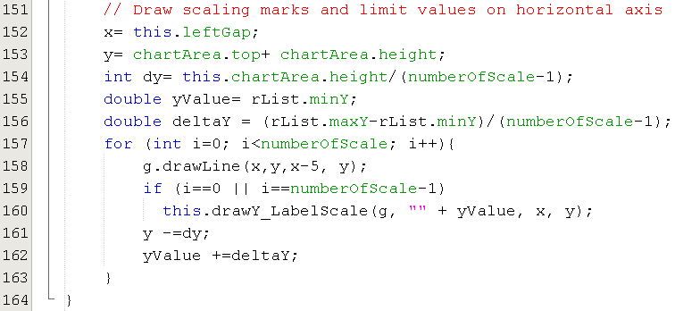
Demo: Code - 16
The method drawScale(..) cont.

Slide 30
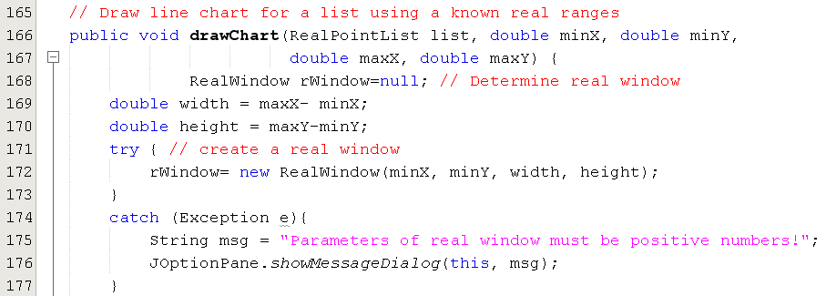
Demo: Code - 17

Slide 31
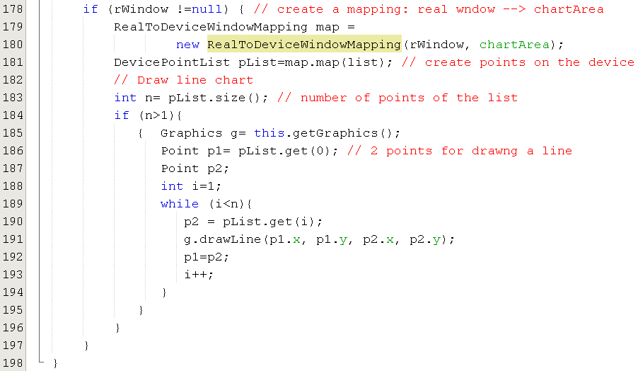
Demo: Code - 18
The method drawChart(…) cont.

Slide 32
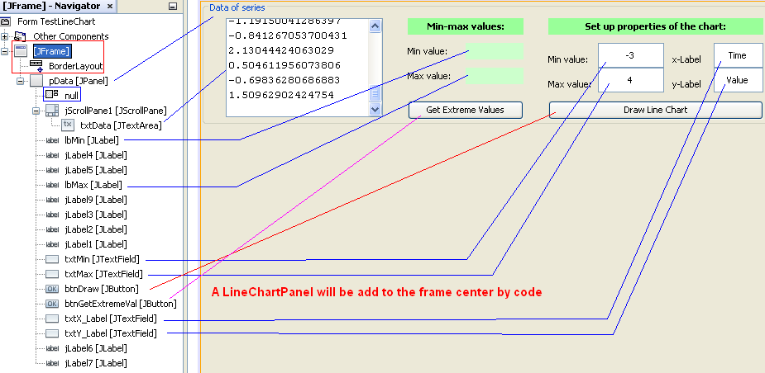
Demo: Code - 19
TestLineChart.java

Slide 33
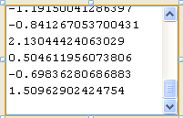
Demo: Code - 20
0.267999733581741
-0.0564639730644435
-0.191168727157551
-0.147829126965571
-0.273163491385384
-0.0728626322272284
0.318367962208834
0.262143372601077
0.211775143973984
-0.220452326788983
-0.184140571878031
0.0302161899464127
-0.281362462021154
-0.213424660980765
-0.295418935737296
0.0302161899464127
-0.22279509960119
-0.295418935737296
-0.213424660980765
-0.213424660980765
-0.0552926192897602
-0.220452326788983
0.494070049468728
0.494070049468728
0.511640111353326
0.426131758957036
-0.213424660980765
-0.295418935737296
0.053643037020138
0.0407579986572305
0.511640111353326
-0.418410511029192
-0.241536955784644
0.361707056613802
-0.447694110660624
0.426131758957036
0.257457990133764
-0.541402086321088
-0.327045308180934
-0.447694110660624
-0.903348493760155
-0.744045000400206
-0.744045000400206
-0.636281203652004
-0.453550961112591
-0.541402086321088
-0.418410511029192
-0.447694110660624
-0.879921744580691
-0.3680426087163
-0.541402086321088
-0.636281203652004
-0.636281203652004
-0.594112598289085
0.879443532401462
0.119238603666753
-0.57771384123204
-0.664393661612984
-0.57771384123204
-0.770985990376532
-0.761615551756108
-0.64916588306929
0.059499871156395
-0.3680426087163
0.523353812257261
-1.14816033951639
-0.761615551756108
0.119238603666753
0.603005803672886
-1.14816033951639
0.47650015074123
0.595977648393366
0.603005803672886
0.919268875480871
0.485870099890352
0.923954421105285
0.603005803672886
0.595977648393366
0.538581101329652
0.485870099890352
0.656887620468437
0.695542311348697
0.618233092745278
0.67328588805418
0.695542311348697
1.06803013592154
2.13044424063029
0.656887620468437
0.695542311348697
1.08794378640385
1.95825476259625
0.618233092745278
1.76849652793441
1.11722754919238
0.504611956073806
1.50962902424754
0.504611956073806
1.95825476259625
2.20423856580844
-1.19150041286397
-0.841267053700431
2.13044424063029
0.504611956073806
-0.69836280686883
1.50962902424754
Property Text:
-0.300104318204609
-0.530859690244707
-0.92209034994361
-0.906862571399915
-0.0166379969354826
-0.860008909883885
-0.175941438085159
-0.92209034994361
-0.191168727157551
0.0817553481397268
-0.300104318204609
-0.860008909883885
-0.0728626322272284
-0.191168727157551
-0.300104318204609
-0.00726706378588532
-0.0740340023176218
-0.0564639730644435
0.262143372601077
0.211775143973984
-0.0166379969354826
0.123924067712617

Slide 34
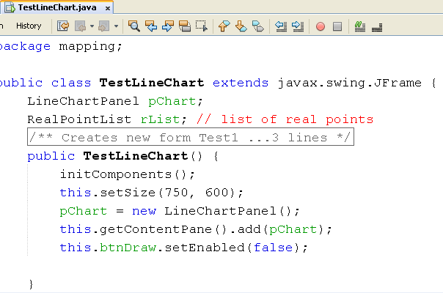
Demo: Code - 21

Slide 35
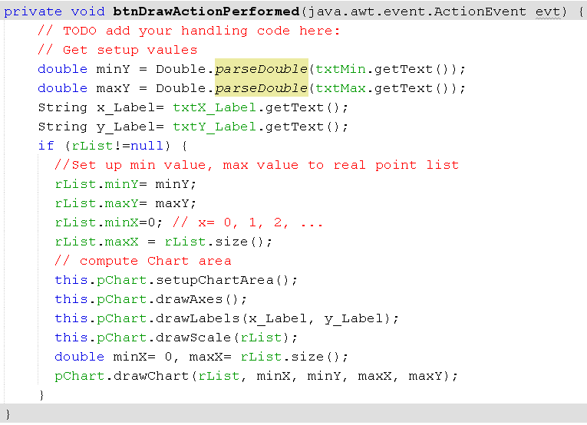
Demo: Code - 22

Slide 36
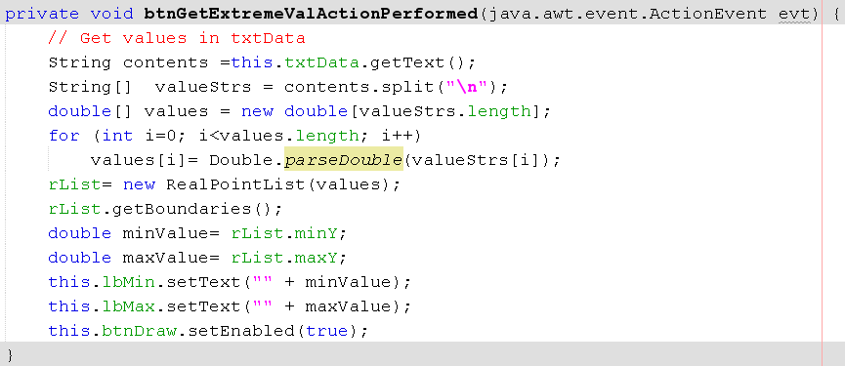
Demo: Code - 23

Slide 37
Summary
Normal Coordinates versus Device Coordinates
Expected Shape
Mapping a Real Point to Device Point
Drawing Area in a Component

